Slide 1

Data Virtualization
PDTool Training Deployment
Presenter
Title

Slide 2
Agenda
PDTool Basic Information
Command-line Execution
PDTool Advanced
PDTool Best Practices
Typical Deployment Scenario

Slide 3
PDTool Basic Information
© Copyright 2000-2017 TIBCO Software Inc.
Notes:
Next, let’s examine some common deployment options for DV.

Slide 4
PDTool: Problem Definition
Promotion
The task of moving DV resources to a target environment.
Every DV project requires the ability to promote resources.
Deployment
The task of importing DV resources into the target DV instance or cluster and configuring them.
Deployment Paradigm
May use Version control.
May choose CAR file import/export.
Configuration
The task of modifying resource attributes on the target DV instance or cluster.
© Copyright 2000-2017 TIBCO Software Inc.

Slide 5
PDTool: Design Philosophy
Support command-line and ant deployment.
Support for java API.
Command-line and ant invokes the same set of modules to avoid duplication of code.
Support both VCS and traditional CAR file based deployments.
Support both local and remote deployment.
Produce a comprehensive set of log files.
Invokes DV web service API.
© Copyright 2000-2017 TIBCO Software Inc.

Slide 6
PDTool: Distribution Folders
PDTool7.0.0 – installation folder
/bin – scripts [ExecutePDTool.bat | .sh]
/docs – documentation and powerpoints
/logs – log files
/resources
/config – configuration property files (variables)
/modules – module XML configuration files
/plans – deployment plan files
Developer Focal point (95% of the on-going work happens here)
/modules – focus on what to configure on the target DV server
/plans – focus on what to execute to the target DV server and sequence
Environment
Command-line – JRE 7 (1.7) or higher
Ant execution – JDK 7 (1.7) or higher
© Copyright 2000-2017 TIBCO Software Inc.

Slide 7
PDTool: Functional Modules
Divided into Modules of functionality
Resource Movement Modules
Archive Module – import, export, backup and restore
VCS Module – VCS deployment
Resource Configuration Modules
Data source Module – manage data sources
Privilege Module – manage resource privileges
Rebind Module – manage rebinding of resources
Resource Cache Module – manage resource cache
Resource Module – manage DV resources
Trigger Module – manage triggers
Non-Resource Configuration Modules
Server Attribute Module – manage server attributes
Server Module – start, stop, restart DV servers
User Module – manage composite users
Group Module – manage composite groups
Resource Testing Modules
Regression Test Module – Testing
functional (smoke test)
regression
migration
performance
security
© Copyright 2000-2017 TIBCO Software Inc.

Slide 8
PDTool Best Practices
© Copyright 2000-2017 TIBCO Software Inc.
Notes:
Next, let’s examine some common deployment options for DV.

Slide 9
Best Practices – Deployment Consistency
Deployment Consistency
Always make modification in Development and push to higher environments.
The value of a PDTool deployment plans is to achieve repeatability and agility.
Why do developers make changes in higher environments directly?
“We don’t have enough time to make changes in development and push them!”
This is a frowned upon practice because it leads to development server inconsistencies and downstream errors during the next deployment.
Making changes directly in higher environments also complicates life from a VCS perspective for check-in.
DEV
DV
Fix
UAT
DV
Fix
PRE-PROD
DV
Fix
PROD
DV
Test
Test
Test
Approved
Approved
Approved
Check in
Done
VCS:
SVN, TFS, etc.
PDTool Deployment Plan
Deploy
Deploy
Deploy
© Copyright 2000-2017 TIBCO Software Inc.
Notes:
Deployment consistency starts with only making modifications in the development environment and using a repeatable deployment and test process to push to higher level environments. The benefit of this is that it keeps development and the version control system synchronized with actual changes that need to be made. Once a change is made in a higher-level environment and it is not made in development, then it becomes too easy to forget to put these changes back into development. This will result in introducing bugs or losing functionality that once had been present in the higher level environments into the software during the next release.
Graphic:
This graphic depicts an environment with Development, UAT (smoke test/functional/regression testing), Pre-Prod (performance testing) and Production (final smoke test). It also shows the use of a version control system and PDTool for deployment. This is a generalization and is meant to depict a general approach. Approaches may vary from customer to customer but the guidelines remain the same as shown here.
Transition 1 – developers check-in code to VCS
Transition 2 – deployment is performed to UAT. Various testing is done such as smoke test, functional and regression tests.
Transition 3 – if issues are reported, a fix is performed in development and re-deployed and re-tested. When approved the next deployment is performed.
Transition 4 – deployment is performed to Pre-Prod. Various testing is done such as performance testing.
Transition 5 – if performance issues are reported, a fix is performed in development and re-deployed and re-tested. When approved the next deployment is performed.
Transition 6 – deployment is performed to Production. Various testing is done such as a smoke test to validate that the published resources work.
Transition 7 – if operational issues are reported, a fix is performed in development and re-deployed and re-tested. What approved the system is live and deployment is done.

Slide 10
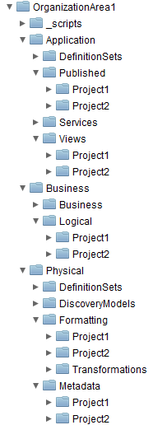
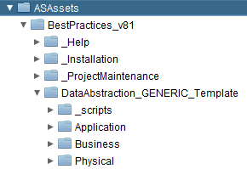
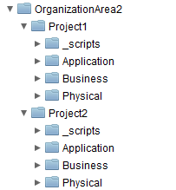
Best Practices – Folders and Privileges
Folder Architecture and Privileges
Deployment strategies must take into account folder hierarchies and privilege strategies.
Use the Data Abstraction Best Practices folder architecture.
Put different “projects”, “business lines/areas” or “subject areas” into their own “separated” folders with their own data abstraction folders.
It is harder to deploy and set privileges on project folders “interspersed” into the data abstraction folders.
Makes deployment at “project” folder level easier.
Makes setting privileges at “project” folder level easier.
Interspersed Projects
X
X
Data Abstraction Best Practices
Separated Projects
X
Easier to deploy and set privileges
X
X
© Copyright 2000-2017 TIBCO Software Inc.

Slide 11
Best Practices – Deployment Development Steps
Configure DV Servers (servers.xml)
Step 1 – Configure DV Servers
Setup a single servers.xml file configured for all environments.
Use a consistent naming convention for the <id> to represent the environments.
Step 2 – Use case deployment plan
Decide on use case for deployment by selecting folders in DV to deploy.
Determine if you will use package import or VCS.
Determine what types of resources need updating upon deployment. e.g. Data sources, Triggers, Rebinding and etc.
Step 3 – Create the deployment plan
Step 4 – Create the module xml configuration files
Use shortcuts by generating module XML files (consult documentation)
Configure VCS Module for VCS-based deployments
Step 5 – Execute the deployment plan
Fix and re-execute as needed
1
Decide use case and deployment plan steps
2
Create Deployment Plan (my_use_case.dp)
3
Configure Module XML (my_module.xml)
4.1
Configure VCS Module XML Configuration File
4.2
Execute Deployment Plan (ExecutePDTool.bat)
5
© Copyright 2000-2017 TIBCO Software Inc.

Slide 12
Best Practices – Deployment Strategies
Basic Strategy
Limited planning is required.
Get a deployment configuration up and running quickly.
Hard-code references to identifiers, paths and etc.
Dynamic Strategy
Requires more planning up front.
Design a parameterized deployment strategy to be used across all environments.
Yields greater benefits towards repeatability and agility
Reduce maintenance of configuration and plan files
Use the same plan file across all environments to promote deployment consistency
Use variables to specify environment differences or refer to environments.
Example: $MODULE_HOME or %MODULE_HOME% are equivalent
© Copyright 2000-2017 TIBCO Software Inc.
Notes:
The basic strategy is just that…basic. For beginners it is the easiest to set up and not a lot of planning has to be put into it. If you want to get PDTool up and running quickly then you may want to start with this strategy especially if you are just trying to show the value of deployment for one environment.
The dynamic strategy requires more planning up front to accommodate all of the environments that you want to deploy to. However, it can yield the greater benefits in terms of flexibility and reducing the maintenance on the number of configuration and plan files. With a little planning, a user can design a parameterized deployment strategy that can be used across all environments. Use variables so the same deployment plan can be used when deploying to all environments.

Slide 13
Typical Deployment Scenario
© Copyright 2000-2017 TIBCO Software Inc.
Notes:
Next, let’s examine some common deployment options for DV.

Slide 14

Typical Deployment Scenario
Scenario 1
Archive (.car) file based deployment between source and target server. Scripts executed on target server.
Scenario 2
Developer checks in resources to VCS
Scenario 3
VCS based deployment. Scripts executed on target DV server.
Scenario 4
VCS-based deployment. Scripts executed on deployment server.
DV Studio
Studio 1
Studio 2
Studio 3
PDTool Studio
PDTool Studio
PDTool Studio
DVco Information Server
PDTool Studio
1
DV Target Server
DV Source Server
PDTool
Deploy
Scripts
Data Virtualization
Data Virtualization
Export Import
2
workspace
Check-in
3
VCS Check-out
Deployment Server: unix, windows
Version Control System (VCS) Server
4
Subversion, TFS, Other..
PDTool
Deploy
Scripts
VCS Check-out
workspace
© Copyright 2000-2017 TIBCO Software Inc.
Notes:
Definitions
Source Environment – this is typically your development environment where DV artifacts originate.
Target Environment – this is typically your INT, TEST, UAT, SIT, or production environment. As mentioned previously, different customers have different names but the intent is the same.
VCS Server – this is the environment where a source code control / version control system is installed. Subversion is one example.
Deployment Server – this is a server that will execute the deployment process and target one of the prior-mentioned target environments. DV is not required to be on this machine.
Deployment Actions – deployment actions are modular and encompass both importing DV resources and configuring resources.
Initial Screen - PDTool Overview
The typical environment contains a shared development server and 1 or more higher level target servers which will be deployed to. In a shared DV development server there are multiple developers that connect to DV. Optionally, there may be a Version Control Server and a separate Deployment server.
Transition 1 – Overlay of PDTool Packages
In the first transition, an overlay of the PDTool packages is shown in perspective of where they can be installed. PDTool Studio is installed on the client computer with DV Studio. PDTool Studio acts as the bridge between Data Virtualization Server and the Version Control System (VCS). PDTool may be installed on a DV server or on a separate deployment server. Many times, it is installed on the client computer of the Deployment Manager.
Transition – 2 Options
Option 1 – Deployment is done through the traditional package export/import mechanism using .car files.
Option 2 – Provides for Developer’s the ability to check-in resources from the Development server into a supported Version Control System of their choice.
Option 3 – Uses the PDTool installation on the target DV server for deployment.
Option 4 – Uses the PDTool installation on a separate deployment server for deployment.

Slide 15
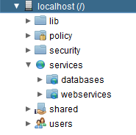
Typical Deployment Scenario Deep Dive
Deployment Plan
Step 1
Option 1 – Perform Archive Module Package Import from a .car file
Option 2 – Perform VCS Module VCS Check-out (3 areas of DV)
Step 2
Perform Data Source Module Update Data Sources
Step 3
Perform Privilege Module Update Privileges
pkg_import $SERVERID “imp1” "$MODULE_HOME/ArchiveModule.xml" "$MODULE_HOME/servers.xml“
vcsCheckout2 $SERVERID $VCONN /services/databases/TEST00 "Data Source" HEAD "$MODULE_HOME/VCSModule.xml“ "$MODULE_HOME/servers.xml“
vcsCheckout2 $SERVERID $VCONN /services/webservices/TEST00/testWS "Composite Web Service" HEAD "$MODULE_HOME/VCSModule.xml“ "$MODULE_HOME/servers.xml“
vcsCheckout2 $SERVERID $VCONN /shared/test00 "Folder" HEAD "$MODULE_HOME/VCSModule.xml“ "$MODULE_HOME/servers.xml"
updateDataSources $SERVERID “ds1, ds2“ "$MODULE_HOME/DataSourceModule.xml" "$MODULE_HOME/servers.xml "
updatePrivileges $SERVERID "priv1" "$MODULE_HOME/PrivilegeModule.xml" "$MODULE_HOME/servers.xml"
© Copyright 2000-2017 TIBCO Software Inc.

Slide 16
Command-Line Execution
© Copyright 2000-2017 TIBCO Software Inc.
Notes:
Next, let’s examine some common deployment options for DV.

Slide 17
PD Tool Command Line Execution
Command Line Execution
Batch (windows) or shell (UNIX) script for execution
ExecutePDTool.bat or .sh
Execute: -exec ../resources/plans/PDTool.dp -config deploy.properties
Initialize: -vcsinit -vcsuser user -vcspassword password
Encrypt: -encrypt ../resources/modules/servers.xml
Driven by a deployment plan file
Sequence of task actions (methods) and arguments
Example – PDTool.dp
© Copyright 2000-2017 TIBCO Software Inc.
Notes:
The PDTool command line batch or shell script is used to “Execute” deployment plans, “Initialize” workspaces or “Encrypt” files with passwords in them. PDTool is driven by a deployment plan file which contains a sequence of task actions or methods along with their arguments.

Slide 18
PD Tool Command Line Anatomy
Command:
ExecutePDTool.bat -exec ..\resources\plans\plan.dp -config deploy.properties
DV 1
DV 2
DV 3
DV Connections
plan.dp:
PASS TRUE ExecuteAction method $SERVERID “moduleID“ "$MODULE_HOME/Module.xml“ "$MODULE_HOME/servers.xml"
© Copyright 2000-2017 TIBCO Software Inc.

Slide 19
DV Connections – Servers.xml
Attribute | Description | Variables allowed
id | A unique identifier for the list of servers. | yes
hostname | The name of the DV host. | yes
port | The port number for either http or https access. Depends on how “allowHttps” is set. | yes
usage | Identifies how this server is used and for documentation purposes only. | yes
user | The user name which used to connect to DV.
encryptedPassword | The password for the user. To encrypt this attribute execute the command: ExecutePDTool.bat –encrypt ..\resources\modules\servers.xml | yes
domain | The domain for the user connecting to DV. | yes
cishome | Identifies the Composite home directory for documentation purposes only. | yes
clusername | Identifies the name of the Composite cluster for documentation purposes only. | yes
site | Identifies the Composite site for documentation purposes only. | yes
useHttps | Identifies whether the connection should be made with http “false” or https “true”. | Yes
allowVariables | Identifies whether variables are allowed within all or none of the variables described here. If the attribute is not present or false then variables are not extracted. If “true”, then any value containing $ or % is interpreted as a variable. Be careful of passwords containing $ or % and allowVariables=true. | yes
DV Connection Information
One time configuration to list out all servers for each environment
Unique entries
Each entry has a unique id referenced by SERVERID= in the configuration property file…e.g. deploy.properties
Example Server Entry:
<?xml version="1.0" encoding="UTF-8"?>
<servers>
<server>
<id>localhost9400http</id>
<hostname>host.domain.com</hostname>
<port>9400</port>
<usage>DEV6.2</usage>
<user>admin</user>
<encryptedpassword>Encrypted:A7F632300BE8F123</encryptedpassword>
<domain>composite</domain>
<cishome>C:\CompositeSoftware\CIS6.2.6</cishome>
<clustername>cluster2</clustername>
<site>US East</site>
<useHttps>false</useHttps>
<allowVariables>true</allowVariables>
</server>
</servers>
© Copyright 2000-2017 TIBCO Software Inc.

Slide 20
Module Configuration – Module.xml
What makes up a module
1. Module Name – The name of the Module.
2. Module Action – The action to be performed against a DV instance.
3. Module XML Property File – The XML configuration file located in PDTool62\resources\modules
Each Module has specific XML configuration
Provides the details of what to configure on the target server
Validated by PDToolModules.xsd
Documented in each module PDF and with PDToolModules.xsd.html found in /docs folder.
Unique entries
Each module has a unique identifier. <id>ds1</id>
It can contain any unique string within the context of that module.xml file.
© Copyright 2000-2017 TIBCO Software Inc.

Slide 21
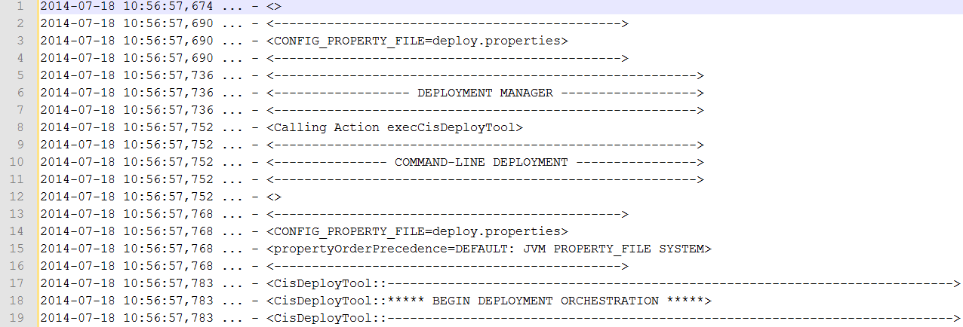
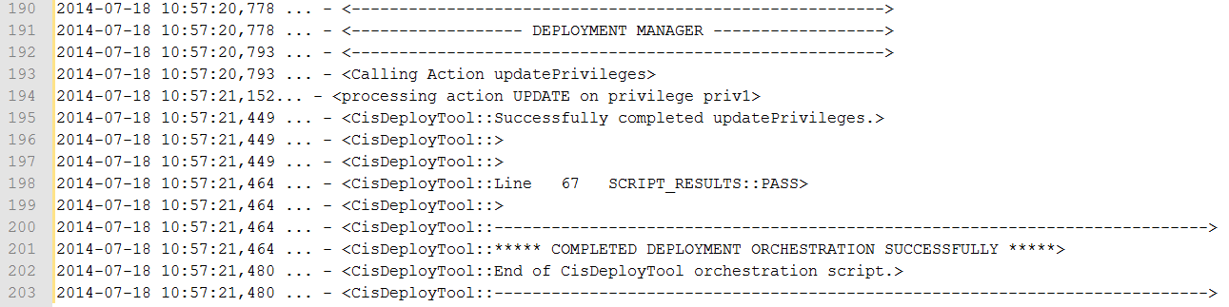
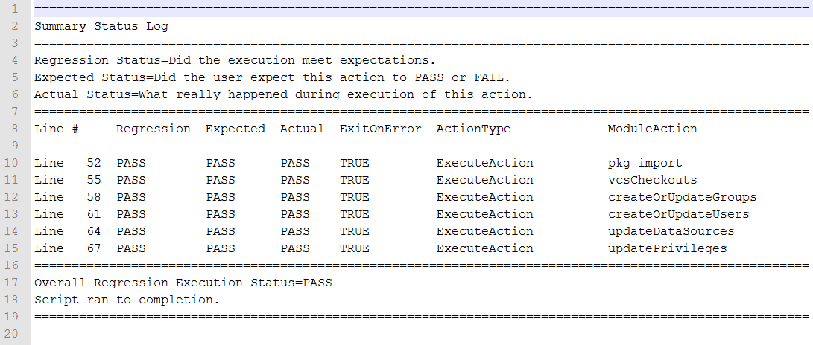
PDTool: Logs
Beginning of Log
Location: PDTool/logs
app.log
provides a rolling log of executions built on log4j
summary.log
single point-in-time execution summary
End of Log
Summary Log
© Copyright 2000-2017 TIBCO Software Inc.

Slide 22
PDTool Advanced
© Copyright 2000-2017 TIBCO Software Inc.
Notes:
Next, let’s examine some common deployment options for DV.

Slide 23
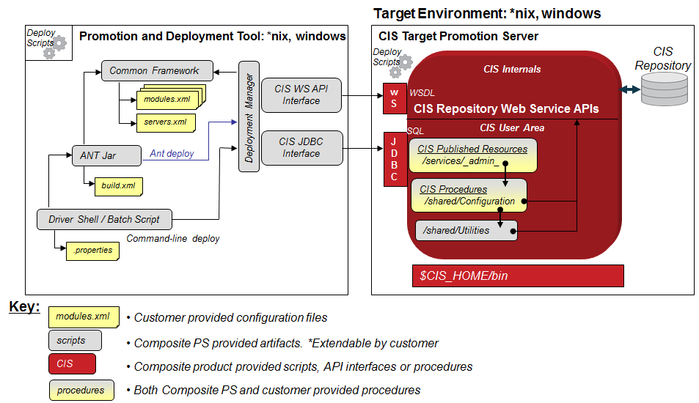
Deployment Architecture
© Copyright 2000-2017 TIBCO Software Inc.
Notes:
Technical Architecture
The design shown in Figure 2 below exemplifies the modular architecture used by the Promotion and Deployment Tool. In the description of each section below, it will be indicated what involvement by the user is required or possible. For any information regarding extending the framework, the user should consult the Developer’s Guide. It is intended that 90% of the functionality of the Promotion and Deployment Tool is provided out of the box.
Shell/Batch Scripts
Driver Script – a single script used to invoke a java command “ExecutePDTool” that will orchestrate through a well-defined property file and execute tasks or actions.
Common Framework
Module Interfaces (Deployment Manager, Module Manager, WS API)
Deployment Manager, Module Manager, DV WS Interface API - contains a single point of interface for both ANT and Command line utilities. It will provide logging, error handling, and XML property file parsing. It will provide a command line interface with the same parameters as ANT uses. It will provide looping through the XML property file, making iterative calls to the DV WS API Interfaces which are largely based on single entry invocations and not lists. It will handle errors in a common way and log them.
DV JDBC Interface Jar – contains a single generic JDBC interface that can invoke any published DV procedure
Common Jar – contains common framework functions that are required by the Interface jars and ant jars. Classpaths and packaging is separate from ANT so that an ant-less deploy can be realized. Contains common code for parsing XML and logging. Built by Composite PS. Generic. No need to extend.
Ant
Ant Jar – contains the necessary modules to execute ANT. Will be able to invoke Java-based interface wrapper modules as well as shell scripts. Its main job is for orchestrating task execution.
Configuration Files
PDTool.dp – provides the sequence of task (actions) for the command line script to orchestrate through. This is known as the “Deployment Plan (dp)”. Configured by customer.
build.xml – provides the sequence of task (actions) for Ant to orchestrate through. Configured by customer.
servers.xml – provides DV server specific information. Configured by customer.
modules.xml – task module specific information. Configured by customer.
DV Published Procedures
DV Published Procedures – published to any virtual database for access via the JDBC interface. Focused on doing configuration. Built by Composite PS or the customer.
DV Procedures – These SQL Script Procedures are focused on performing configuration and provide an easy to use interface for a customer to execute logic within DV. These procedures may invoke DV WS Repository API or they may invoke pre-existing Utility components which in turn invoke the repository API. Built by Composite PS or the customer.
Utilities – Composite Professional Services Asset procedures used to invoke the repository API’s. Built by Composite PS.

Slide 24
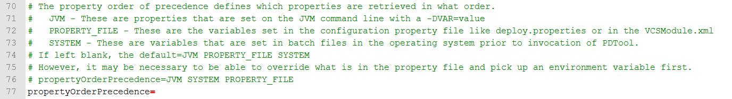
Advanced – Dynamic Deployment Strategy
Dynamic Strategy (use variables)
Use variables to specify environment differences or refer to environments.
Variables are acquired from
System “OS Environment” – set by batch or shell script, setVars.bat, setMyVars.bat
Java JVM Environment – set by -DVAR=value upon execution of java.exe
Configuration Property File – specified by -config or the default “deploy.properties”.
Variables can be used in configuration property files, plan files and module files
Property order of precedence can be altered on how variables are retrieved
Default: JVM PROPERTY_FILE SYSTEM
Snapshot of default configuration property file – “deploy.properties”
© Copyright 2000-2017 TIBCO Software Inc.
Notes:
The basic strategy is just that…basic. For beginners it is the easiest to set up and not a lot of planning has to be put into it. If you want to get PDTool up and running quickly then you may want to start with this strategy especially if you are just trying to show the value of deployment for one environment.
The dynamic strategy requires more planning up front to accommodate all of the environments that you want to deploy to. However, it can yield the greater benefits in terms of flexibility and reducing the maintenance on the number of configuration and plan files. With a little planning, a user can design a parameterized deployment strategy that can be used across all environments. Use variables so the same deployment plan can be used when deploying to all environments.

Slide 25

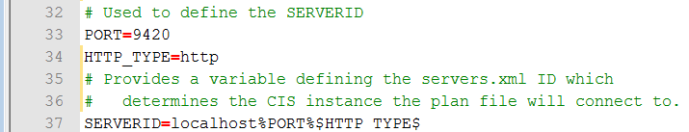
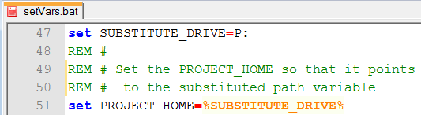
Advanced – Dynamic Deployment Strategy (cont.)
Parameterized deployment plan file line
updateDataSources $SERVERID “ds1, ds2“ "$MODULE_HOME/DataSourceModule_$ENVIRONMENT.xml" "$MODULE_HOME/servers.xml”
Resolved deployment plan file line
updateDataSources localhost9420http “ds1, ds2“ “P:/resources/modules/DataSourceModule_UAT.xml" “P:/resources/modules/servers.xml “
Resolves to: localhost9420http
Resolves to: DataSourceModule_UAT.xml
$SERVERID provides a pointer to the DV server connection set by an environment-specific configuration property file “deploy.properties”
Resolves to: P:/resources/modules
Resolves to: P:
© Copyright 2000-2017 TIBCO Software Inc.
Notes:
The basic strategy is just that…basic. For beginners it is the easiest to set up and not a lot of planning has to be put into it. If you want to get PDTool up and running quickly then you may want to start with this strategy especially if you are just trying to show the value of deployment for one environment.
The dynamic strategy requires more planning up front to accommodate all of the environments that you want to deploy to. However, it can yield the greater benefits in terms of flexibility and reducing the maintenance on the number of configuration and plan files. With a little planning, a user can design a parameterized deployment strategy that can be used across all environments. Use variables so the same deployment plan can be used when deploying to all environments.

Slide 26
Q&A
© Copyright 2000-2017 TIBCO Software Inc.
Notes:
Next, let’s examine some common deployment options for DV.

Slide 27
Extra Slides
© Copyright 2000-2017 TIBCO Software Inc.
Notes:
Next, let’s examine some common deployment options for DV.

Slide 28
PDTool Configuration Process
© Copyright 2000-2017 TIBCO Software Inc.
Notes:
Next, let’s examine some common deployment options for DV.

Slide 29
PD Tool VCS Configuration Process
Prepare VCS Repository (admin)
1
Install
PD Tool
2
Configure VCS Environment Properties
VCS specific
3
VCS specific
4.1
Initialize VCS Workspace
4.2
Initialize VCS Base Folders (admin)
5
Configure VCS Module XML Configuration File
Repeat for different deployment scenarios
Configure VCS Deployment Plan File
Repeat for different deployment scenarios
6
7
Test VCS
© Copyright 2000-2017 TIBCO Software Inc.
Notes:
Prepare VCS Repository – an administrator uses native VCS tools to create a “repo” for DV to check-in resources.
Install PDTool – install according to installation instructions
VCS command line utility must be installed on same machine.
Configure VCS Environment Properties – properties may be configured in one or all of environment batch files, deployment configuration property files or VCS Module XML property files.
4.1 Initialize VCS Workspace – executing VCS Init initializes the local workspace with what is in the VCS system. This is a pre-requisite to using VCS.
4.2 Initialize VCS Base Folders – this is a one-time, optional operation performed by an admin in a multi-tenant environment where only certain folders will be checked in under version control. This alleviates having to check-in the entire DV repository which could be quite large.
5. Configure VCS Module XML configuration file – this XML file allows for multiple VCS configurations to be referenced. The multiple references may be different VCS systems like subversion and TFS or they may be different URLS within the same VCS systems.
6. Configure VCS Deployment Plan File – the deployment plan is the heart of PDTool. It defines the order and methods that will be executed upon deployment.
7. Test VCS – run the deployment plan through a test execution in a lower environment to insure the plan is working as desired before running in production.

Slide 30
PDTool Internal Architecture
© Copyright 2000-2017 TIBCO Software Inc.
Notes:
Next, let’s examine some common deployment options for DV.

Slide 31
Design Philosophy
Support Command-line and Ant deployment.
Support for Java API
Command-line and Ant invokes the same set of modules to avoid duplication of code.
Support both VCS and traditional CAR file based deployments.
Support both local and remote deployment
Produce a comprehensive set of log files
Invokes DV Web Service API
© Copyright 2000-2017 TIBCO Software Inc.

Slide 32
Design Philosophy
Modular Approach
A module is a functional grouping of actions
Generate, Create, Update, Delete
Invoked via command line, shell script or Java program and accepts input arguments.
Driven by XML-based configuration files containing an iteration of DV resources.
Swap in module(s) of customer’s choice using Spring for Java Modules or SQL invocations for DV SQL Script Procedures.
© Copyright 2000-2017 TIBCO Software Inc.

Slide 33


PDTool Architecture Overview
Promotion and Deployment Tool Framework
Target Environment: *nix, windows
Deploy
Scripts
Promotion and Deployment Tool: *nix, windows
DV Target Promotion Server
Deploy
Scripts
DV
Repository
Common Framework
DV Internals
DV User Area
module.xml
DV WS API Interface
WS
WSDL
module.xml
modules.xml
Deployment Manager
DV Repository Web Service APIs
servers.xml
SQL
DV JDBC Interface
JDBC
DV Published Resources
/services/_admin_
ANT Jar
Ant deploy
build.xml
DV Procedures
/shared/Configuration
Driver Shell / Batch Script
Command-line deploy
/shared/Utilities
.properties
$DV_HOME/bin
Key:
modules.xml
Customer provided configuration files
scripts
Composite PS provided artifacts. *Extendable by customer
DV
Composite product provided scripts, API interfaces or procedures
procedures
Both Composite PS and customer provided procedures
© Copyright 2000-2017 TIBCO Software Inc.
Notes:
Deployment Framework Artifacts
DV Interface Procedures
DV Interface Wrapper – contains a single point of interface for both ANT and Command line utilities. It will provide logging, error handling, XML property file parsing. It will provide a command line interface with the same parameters as ANT uses. It will provide looping through the XML property file, making iterative calls to the DV WS API Interfaces which are largely based on single entry invocations and not lists. It will handle errors in a common way and log them.
Built by Composite PS. No need to extend.
DV WS API Interface Jar – contains individual interface functions for each DV WS Repository API
Built by Composite PS. May be extended by a customer.
DV JDBC Interface Jar – contains a single generic JDBC interface that can invoke any published DV procedure
Built by Composite PS. No need to extend.
Modular Wrapper Shell/Batch Scripts
Modularized wrapper shell/batch script to invoke a single function in the DV WS Jar file – no parsing of arguments – all command line driven (one script for each function).
Built by Composite PS. May be extended by a customer.
Wrapper shell/batch script to interface with DV JDBC Jar file
Built by Composite PS. No need to extend by a customer. Pass in parameters to effect behavior.
Wrapper shell/batch script to interface with DV VCS scripts
Built by Composite PS. May need to extend to different VCS systems.
Wrapper shell/batch script (if needed) to interface with DV shell/batch scripts.
Built by Composite PS. No need to extend.
Common Framework
Common Jar – contains common framework functions that are required by the Interface jars and ant jars. Classpaths and packaging is separate from ANT so that an ant-less deploy can be realized. Contains common code for parsing XML and logging.
Built by Composite PS. No need to extend.
Ant
Ant Jar – contains the necessary modules to execute ANT. Will be able to invoke Java-based interface wrapper modules as well as shell scripts. Depending on the implementation, ant may invoke a PS provided wrapper script or it may invoke the DV-product provided scripts. Either way, access to a Composite Installation home directory will be required on the server where the scripts are being executed. Very important --- It’s main job is for orchestrating task execution.
Built by Composite PS. No need to extend.
Configuration XML Files
build.xml – provides build environment information
Configured by customer.
servers.xml – provides server DV specific information
Configured by customer.
modules.xml – task module specific information.
Configured by customer.
Driver Shell/Batch Scripts
Driver shell/batch script to execute a deployment
Built by Composite PS. No need to extend.
XML parser Jar – parse out the xml configuration files into properties for driver shell script to use
Built by Composite PS. No need to extend.
DV Published Procedures
DV Published Procedures – published to the _admin_ virtual database for access via the JDBC interface. Focused on doing configuration.
Built by Composite PS or the customer.
DV Procedures – These SQL Script Procedures are focused on performing configuration and provide an easy to use interface for a customer to execute logic within DV. These procedure may invoke DV WS Repository API or they may invoke pre-existing Utility components which in turn invoke the repository API.
Built by Composite PS or the customer.
Utilities – Composite Professional Services Asset procedures used to invoke the repository API’s.
Built by Composite PS or the customer.

Slide 34


PDTool Internal Architecture
[PDTool] Promotion and Deployment Tool Framework: UNIX and windows
PDTool Project
Ant Deployment
Deployment Manager
Module Manager
DV WS API Interface
CompositeAntTask
DeployManager
{Module}Manager
{Module}DAO
GetLicensesAntTask
DeployManagerImpl
{Module}ManagerImpl
{Module}WSDAOImpl
DeployManagerUtil
module.xml
DV JDBC Interface
module.xml
modules.xml
Included Libraries
servers.xml
JdbcDAO
CisAdminApi
Common Framework
JdbcDAOImpl
PDToolModules
BasicAuthenticator
DV Common Logging
Exception
Logger
log4j, slf4j
sax, jaxen
CommonUtil
CisWSHelper
xalan, xerces
spring
PropertyMngr
XMLUtil
PDTool Deploy Scripts
PDToolModules
ant
Deploy
Scripts
PDToolModules
build.xml
JDK6,7
JRE6,7
PDToolModules.xsd
{Module}Type (JAXB)
ExecutePDTool.bat /.sh
deploy.properties
ObjectFactory (JAXB)
© Copyright 2000-2017 TIBCO Software Inc.
Notes:
Deployment Framework Artifacts
DV Interface Procedures
DV Interface Wrapper – contains a single point of interface for both ANT and Command line utilities. It will provide logging, error handling, XML property file parsing. It will provide a command line interface with the same parameters as ANT uses. It will provide looping through the XML property file, making iterative calls to the DV WS API Interfaces which are largely based on single entry invocations and not lists. It will handle errors in a common way and log them.
Built by Composite PS. No need to extend.
DV WS API Interface Jar – contains individual interface functions for each DV WS Repository API
Built by Composite PS. May be extended by a customer.
DV JDBC Interface Jar – contains a single generic JDBC interface that can invoke any published DV procedure
Built by Composite PS. No need to extend.
Modular Wrapper Shell/Batch Scripts
Modularized wrapper shell/batch script to invoke a single function in the DV WS Jar file – no parsing of arguments – all command line driven (one script for each function).
Built by Composite PS. May be extended by a customer.
Wrapper shell/batch script to interface with DV JDBC Jar file
Built by Composite PS. No need to extend by a customer. Pass in parameters to effect behavior.
Wrapper shell/batch script to interface with DV VCS scripts
Built by Composite PS. May need to extend to different VCS systems.
Wrapper shell/batch script (if needed) to interface with DV shell/batch scripts.
Built by Composite PS. No need to extend.
Common Framework
Common Jar – contains common framework functions that are required by the Interface jars and ant jars. Classpaths and packaging is separate from ANT so that an ant-less deploy can be realized. Contains common code for parsing XML and logging.
Built by Composite PS. No need to extend.
Ant
Ant Jar – contains the necessary modules to execute ANT. Will be able to invoke Java-based interface wrapper modules as well as shell scripts. Depending on the implementation, ant may invoke a PS provided wrapper script or it may invoke the DV-product provided scripts. Either way, access to a Composite Installation home directory will be required on the server where the scripts are being executed. Very important --- It’s main job is for orchestrating task execution.
Built by Composite PS. No need to extend.
Configuration XML Files
build.xml – provides build environment information
Configured by customer.
servers.xml – provides server DV specific information
Configured by customer.
modules.xml – task module specific information.
Configured by customer.
Driver Shell/Batch Scripts
Driver shell/batch script to execute a deployment
Built by Composite PS. No need to extend.
XML parser Jar – parse out the xml configuration files into properties for driver shell script to use
Built by Composite PS. No need to extend.
DV Published Procedures
DV Published Procedures – published to the _admin_ virtual database for access via the JDBC interface. Focused on doing configuration.
Built by Composite PS or the customer.
DV Procedures – These SQL Script Procedures are focused on performing configuration and provide an easy to use interface for a customer to execute logic within DV. These procedure may invoke DV WS Repository API or they may invoke pre-existing Utility components which in turn invoke the repository API.
Built by Composite PS or the customer.
Utilities – Composite Professional Services Asset procedures used to invoke the repository API’s.
Built by Composite PS or the customer.

Slide 35
PDTool Development - Interfaces
DV Web Service Interface
Smallest amount of code possible required to interface with DV x.x web service API generated classes.
This should be a very thin layer on top of our WS API. All parameters are pass-through. No logic lives here.
Handles exceptions from DV
Handles output standardization and exceptions
DV Published Procedures
Generically invoke published procedures using the executeProcedure() Web Service API.
© Copyright 2000-2017 TIBCO Software Inc.

Slide 36
PDTool Development – Module Manager
Module Manager and Web Service API Conventions
Module Manager
Package: com.tibco.ps.deploytool.services
Resource APIs
TriggerMananger.updateTriggerSchedule
DataSourceManager.updateDataSources
User APIs
UserManager.createOrUpdateUsers
Server APIs
ServerAttrManager.updateServerAttributes
DV WS API Interface
Package for DV Web Service API: com.tibco.ps.deploytool.dao & .wsapi
Resource APIs
TriggerDAO → TriggerWSDAOImpl
DataSourceDAO → DataSourceWSDAOImpl
User APIs
UserDAO → UserWSDAOImpl
.createUser
.UpdateUser
.getUser
Server APIs
ServerAttrDAO → ServerAttrWSDAOImpl
.updateServerAttributes
Module Manager Notes
Will contain Public interfaces for ANT and Command line.
May contain interfaces with business logic that invoke more than one DV WS API
Will contain a one for one interface to the DV WS API
© Copyright 2000-2017 TIBCO Software Inc.

Slide 37
PDTool Development – Module Manager
Module Manager {Module}ManagerImpl
Implements a common pattern within a module:
Common interface for Ant or command line
Common XML property file (modules.xml) parsing
Iterate over lists of properties with invocation to the DV Web service or JDBC interface for each instance.
Common logging
Common exception handling
Common pattern for invoking the Web Service or JDBC API
Common parameter formulation and construction is done in this module.
This way, the interface can invoke either JDBC or Web Services API.
© Copyright 2000-2017 TIBCO Software Inc.

Slide 38
PDTool Development – Common Framework
Common Framework
Logging
XML Utilities for XML Property file parsing
Password encryption/decryption
Common Utilities
Error handling
DV x.x web service API generated jar for JAXB classes
© Copyright 2000-2017 TIBCO Software Inc.

Slide 39
PDTool Command Line Execution
Command Line Execution
One shell/batch script for orchestration
ExecutePDTool.bat or .sh
-exec ../resources/plans/PDTool.dp
Other capabilities:
-vcsinit -vcsuser user -vcspassword password
-encrypt ../resources/modules/servers.xml
Driven by a property file containing task actions
PDTool.dp
List of task actions and arguments
Shell/Batch script invokes main program
PDTool – Orchestration implemented in Java
DeployManagerUtil – Common interface for command line and Ant
© Copyright 2000-2017 TIBCO Software Inc.
Notes:
The main program calls various modules. Most of the modules should be out of box as provided by this solution. A few will be modified or swapped.
The pesudo code is simplified. In practice, it will contain some input parameters.
Each module can receive input parameters if there are only a few of them. If there are a lot, it will read from the config files itself.
Deploy_workspace deploys the necessary files to the target server. It can be file copy, FTP, “svn update” or even via a CD/DVD (classified networks).
Deploy_base_code_via_svn will take what is stored in Subversion, package them up into a checkout.car file, and import it. It is comparable to deploy_base_code_via_car.
The ‘base code’ part means it just contains what came from DEV, so it does not have the environment-specific variations.
Configure_env_specific_settings will overwrite the imported DV objects and replace them with environment-specific settings, such as data source URLs, data source passwords, permissions, etc.
Configure_server_settings will update the DV server settings such as Java heap size, SQL case sensitivity, etc.
We recommend restarting DV after each deployment because something might break and it may not surface until after a restart.
Verification_test will look for changes associated with this round of deployment. For example, if a new data source was added, it should check that it was properly created.
Regression_test will exercise a suite of existing views and procedures whether they have been modified in this round of deployment or not.
Notify_deployment_status can send an email about the result of the deployment.

Slide 40
PDTool Development – Ant
ANT
Main objective is for orchestrating target tasks based on build.xml
Code is separate from Framework code – invokes common code
Invoked with a script to set environment variables
There is no development required for Ant integration.
© Copyright 2000-2017 TIBCO Software Inc.

Slide 41
PDTool Ant Execution
Ant Execution
One shell/batch script for orchestration
ExecutePDTool.bat or .sh
-ant ../resources/ant/build.xml
Other capabilities
-vcsinit -vcsuser user -vcspassword password
-encrypt ../resources/modules/servers.xml
Driven by a build file containing task actions
Build.xml
List of task actions and arguments
Ant invokes a set of Ant targets.
CompositeAntTask– Common invocation for Ant
DeployManagerUtil – Common interface for command line and Ant
© Copyright 2000-2017 TIBCO Software Inc.
Notes:
The main program calls various modules. Most of the modules should be out of box as provided by this solution. A few will be modified or swapped.
The pesudo code is simplified. In practice, it will contain some input parameters.
Each module can receive input parameters if there are only a few of them. If there are a lot, it will read from the config files itself.
Deploy_workspace deploys the necessary files to the target server. It can be file copy, FTP, “svn update” or even via a CD/DVD (classified networks).
Deploy_base_code_via_svn will take what is stored in Subversion, package them up into a checkout.car file, and import it. It is comparable to deploy_base_code_via_car.
The ‘base code’ part means it just contains what came from DEV, so it does not have the environment-specific variations.
Configure_env_specific_settings will overwrite the imported DV objects and replace them with environment-specific settings, such as data source URLs, data source passwords, permissions, etc.
Configure_server_settings will update the DV server settings such as Java heap size, SQL case sensitivity, etc.
We recommend restarting DV after each deployment because something might break and it may not surface until after a restart.
Verification_test will look for changes associated with this round of deployment. For example, if a new data source was added, it should check that it was properly created.
Regression_test will exercise a suite of existing views and procedures whether they have been modified in this round of deployment or not.
Notify_deployment_status can send an email about the result of the deployment.

